Slide 1
THE FOUNDATION OF QUALITY PATIENT CARE
BEYOND OUR SURGICAL TECH SKILLS...
Notes:
The foundation is to model and teach virtues that will cultivate personal well-being.
These virtues will allow us to send our graduates to the OR emotionally prepared with what has been called since long ago “touchstones of goodness” and common sense that result in a safer work environment, higher quality patient care, and a more a satisfying work and personal life balance.

Slide 2
THE CHALLENGE:
LIKE MANY OTHER INDUSTRIES, HEALTHCARE IS EXPERIENCING CHALLENGING TIMES
Workforce shortages
Decline in competency, experience in those that do report
Other Challenges-increased patient load, cost-containment, legal litigation & cybersecurity
Notes:
Since 2020 alone, over 330K healthcare professionals quit or retired -- 1 in 5 healthcare providers.
Projections indicate shortage of 100K doctors in next 7-12 years.
3 million nurses in the next 2 years.
In what some call the Great Resignation, we lost a lot of talent and experience that would have otherwise been passed down to newer personnel.
AND OTHER CHALLENGES FOR HOSPITALS INCLUDE
Cybersecurity threats. 2021 rate of cybersecurity attacks healthcare institutions TRIPLED.
50 MILLION INSTITUTIONS HAD breached data that caused costly shutdowns and a decrease in patient trust.
_________________________________________________________________________
increased productivity demands, cost-containment requirements, and fear of litigation in the healthcare environment.
https://www.the-hospitalist.org/hospitalist/article/121391/tips-working-difficult-doctors
Haines, Julia. “The State of the Nation’s Nursing Shortage | Healthiest Communities ...” The State of the Nation's Nursing Shortage, U.S. News & World Report , 1 Nov. 2022, https://www.usnews.com/news/health-news/articles/2022-11-01/the-state-of-the-nations-nursing-shortage.
(Source the Nurse shortage; looking ahead to 2023. Nurse.com 12-21-2022)
PrognoCIS. “Major Challenges Facing the Healthcare Industry Today.” PrognoCIS EHR, PrognoCIS By Bizmatics, 24 May 2022, https://prognocis.com/challenges-in-healthcare-industry/.

Slide 3
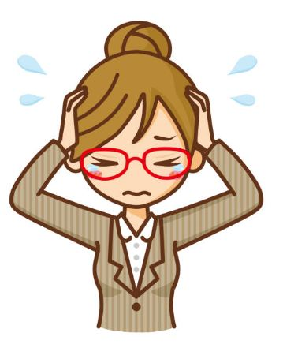
THE RESULT: RISING EMPLOYEE STRESS LEVELS
2013 – Nursing in Top 20 of Unhappiest Professions
2022 –#2 of Unhappiest Professions
#3—TEACHERS
Notes:
TEN YEARS AGO…
NURSES CITE LONG HOURS, lack of support, high stress settings and non safe working conditions for themselves and their patients. OVERTIME-and emotional demands of having to choose between their jobs and family
Teachers cite:
company culture; bosses and compensation for non-teaching related requirements
lack of motivation respect from students…
Students cited:
Social anxiety, general anxiety, test anxiety, or panic attacks.
Family problems.
Depression, low self-esteem, loneliness.
(#1 UNHAPPIEST was security officer- late nights, unsafe conditions and low pay.)

Slide 5
THE QUESTION:
SO, WHO IS HAPPY AT WORK (OR ANYWHERE)?
Lumberjacks! They report the highest level of happiness, the most meaning and the least amount of stress!
AND
Those who feel they are sharing unique, appreciated skills with those who need them most—whether at work or in life in general.
Evidence supports that those who live with purpose have better overall mental and physical health.
American Journal of Health Promotion, August 2021
Notes:
Lumberjacks (per web article (cited): the happiest, most meaningful, least stressful level jobs) (Bureau of Labor Statistics’ American Time Use Survey.)
Leikvoll, Vanessa. “Need a Change? Here Are 25 of the Happiest Jobs That Make over $50k .” Leaders.com, 2 Nov. 2022, https://leaders.com/articles/business/happiest-jobs/.
Kim, Eric S., et al. Sense of Purpose in Life and Subsequent Physical, Behavioral, and Psychosocial Health: An Outcome-Wide Approach , Sage Journals American Journal of Health Promotion , 18 Aug. 2021, https://journals.sagepub.com/doi/10.1177/08901171211038545.

Slide 6
CONSIDER:
WE KNOW OUR WORK IS MEANINGFUL, BUT…
Scores On Scale of 1 to 6
Notes:
Higher stress levels lower our HAPPINESS LEVEL.
Question: How are we handling stress? Gina ask this question:

Slide 8
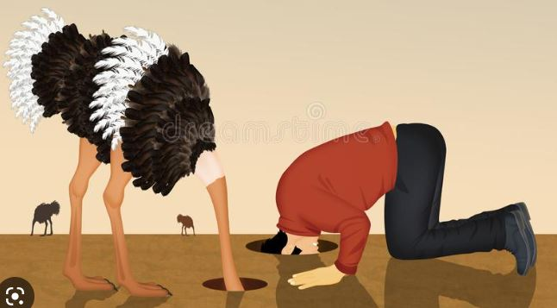
COMMON NATURAL REACTIONS TO STRESS:
…ALSO KNOWN AS WHAT WILL NOT HELP IN A CRISIS!
Being Hostile, Uncooperative, Passive Aggressive
Avoiding Conflict
Complaining- it’s a disease! more viral and virulent than ANY other!
Notes:
In a TED TALK called a World Without Complaining, the speaker listed the top reasons people complain:
1. To get attention
2. inspire envy (or brag), notice the TONE!
3. make themselves more powerful I have all these responsibilities because I’m in charge of so many things
4. remove responsibility or to excuse poor performance. I cannot do my job because… or I was doing this or that because someone else wasn’t doing it, and….
Bonus reason: because we don’t know how else to communicate.
Highly Recommend:
Top 5 REASONS people complain A World without complaining” Will Bowen TED TALK
Wear a complaining bracelet and try not to complain for 21 Days. The physical action makes a connection with your brain regarding how often we complain and how bad our complaining habit may be.
“A World Without Complaining.” A World without Complaining, TED Talk, TED Ideas Worth Spreading, Jan. 2018, https://www.ted.com/talks/will_bowen_a_world_without_complaining_jan_2018. Accessed 23 Jan. 2023.

Slide 9
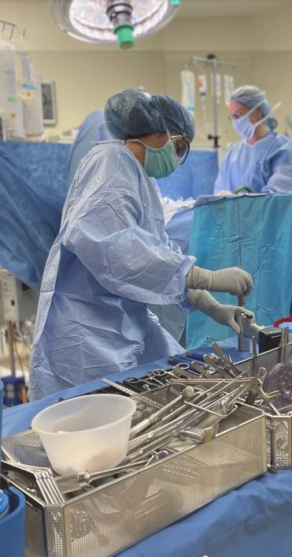
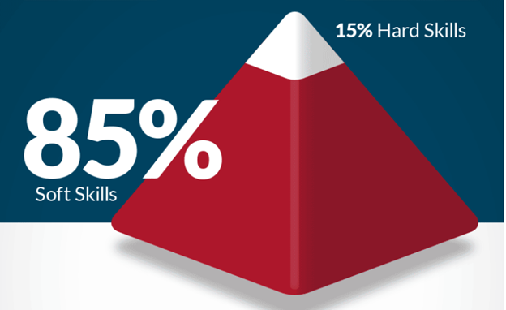
ATTITUDE AND OTHER SOFT SKILLS:
ACCORDING TO EMPLOYERS:
Attitude
Communication
Teamwork
Cooperation
Critical Thinking
Professionalism
Respect
Adaptability
Time Management
Empathy
VITAL IN
GETTING & KEEPING
A JOB
Notes:
In a TED TALK called a World Without Complaining, the speaker listed the top reasons people complain:
1. To get attention
2. inspire envy (or brag), notice the TONE!
3. make themselves more powerful I have all these responsibilities because I’m in charge of so many things
4. remove responsibility or to excuse poor performance. I cannot do my job because… or I was doing this or that because someone else wasn’t doing it, and….
Bonus reason: because we don’t know how else to communicate.
Highly Recommend:
Top 5 REASONS people complain A World without complaining” Will Bowen TED TALK
Wear a complaining bracelet and try not to complain for 21 Days. The physical action makes a connection with your brain regarding how often we complain and how bad our complaining habit may be.
“A World Without Complaining.” A World without Complaining, TED Talk, TED Ideas Worth Spreading, Jan. 2018, https://www.ted.com/talks/will_bowen_a_world_without_complaining_jan_2018. Accessed 23 Jan. 2023.

Slide 11
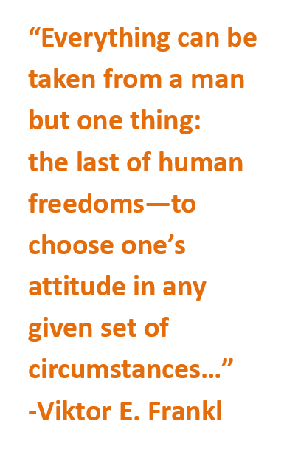
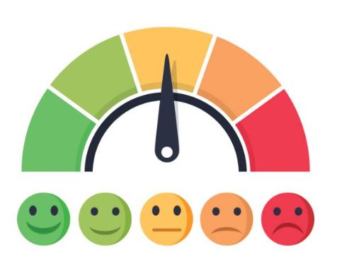
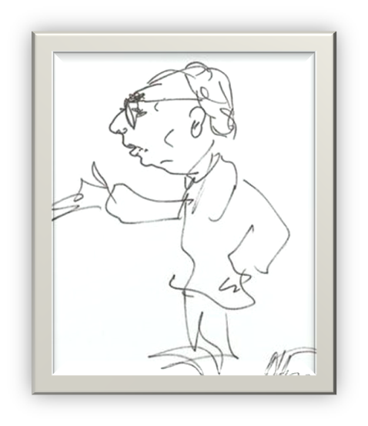
WE CAN HAVE A BETTER ATTITUDE…
…AND WE MUST DO BETTER
Our Choice
Notes:
Sometimes we forget attitude is a choice.
To give context to this quote, This is from VIKTOR FRANKL. He was author …Mans Search for Meaning, one of the most influential books of recent history. He was a Jewish psychiatrist and who was taken to a Nazi concentration camp during the Holocaust. While a prisoner, he and other men experienced the most extreme and unimaginable conditions–naked, sleeping in feces, with dead bodies, starvation, torture, knowing their family members were murdered, and he didn’t know if he would make it out alive. But while there he observed and journaled the behavior and nature of the men in these circumstances.
Frankl wrote “, MEN WALKED AROUND COMFORTING OTHERS, AND GAVE AWAY THEIR LAST PIECE OF BREAD. THESE MEN OFFER SUFFICIENT PROOF THAT…we can choose our attitude.”
The best of us coming out in the worst of times does not and cannot “just happen.”

Slide 12
LOGOTHERAPY
…UNDERSTANDING MEANING AND PURPOSE
If we do not grasp the concept of doing meaningful things, we become caught in an existential vacuum—looking to our surroundings for comfort and pleasure to obtain happiness and mental homeostasis.
This is a common and deadly mistake!
Notes:
Dr. Frankl was the founder of LOGO therapy which is still used today. He helped people with depression and other mental disturbances by offering therapy based strictly on finding meaning and CARING ABOUT SOMETHING outside of ourselves.

Slide 13
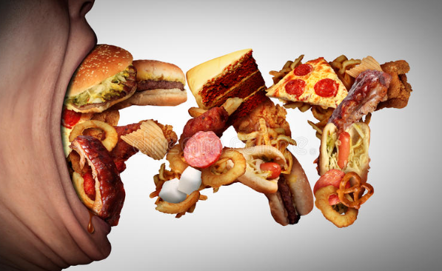
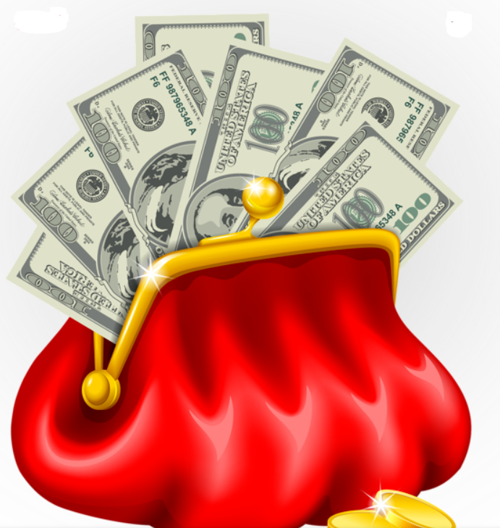
THE EXISTENTIAL VACUUM:
…EXPECTING CONTINUOUS COMFORT & EASE
We want:
to fit in and, not stand out
Only pleasure
For things to go according to our priorities, values & desires
People to think the way we do, or to only be around those people
An “easy” life
ME
Notes:
GINA: AUDIENCE: Name other things that don’t go our way.
People do things the way I do, etc. How to set up a back table, how to clean, etc.
Many times we are only reacting to what we see that doesn’t align with our thinking. And we grow continually annoyed and dissatisfied. This leads to seeking out more pleasure and may be the reason we see so much overindulgence in various areas.
Do things always go our way? If we expect that they should, and they don’t, what is the result??

Slide 14
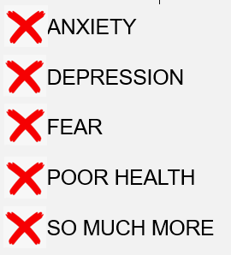
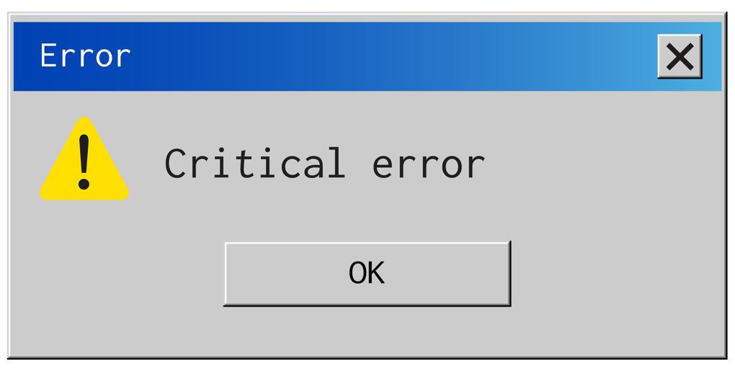
ALERT: CRITICAL ERROR
…OUR ENVIRONMENT WON’T COOPERATE WITH US
“WHEN WE ARE NO LONGER ABLE TO CHANGE A SITUATION,
WE ARE CHALLENGED TO CHANGE OURSELVES.” –VIKTOR FRANKL
Notes:
AND WHO IS TO SAY WE ARE RIGHT ANYWAY? WHY SHOULD THE WORLD COOPERATE WITH US?
How successful have we been with making others cooperate with us? How does that leave us feeling?
Frankl says: READ QUOTE ABOVE.
LET’S THINK ABOUT CHANGING, SHALL WE?

Slide 15
“WHEN OUR THINKIN’ IS STINKIN’…
…ITS TIME FOR A CHECKUP FROM THE NECK UP”
We need to do things, or to realize that what we are doing now, is making a difference.
This can come from meaningful work, hobbies or a cause we feel strongly about, that make a difference to others.
While counterintuitive, doing something difficult that is rewarding, is good for your psyche and results in a happier, more meaningful life.
Notes:
Quote: Dr. Adolph Brown, III, AST National Conference, Maryland, 2017

Slide 16
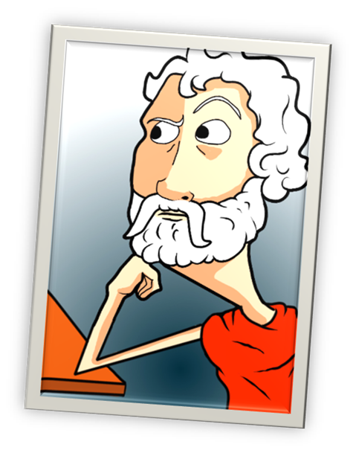
THE CHOICE IS OURS, EVERYDAY, EVERY HOUR…
…VICE OR VIRTUE?
VICE:
Easy, Indulgent, Comfortable
or Well-trodden
VIRTUE (arete):
“Excellence-The Act of Living
One’s Full Potential”
STAY THE SAME) OR GO BACKWARDS
EASY WAY
COWARD
FOLLOW THE CROWD
BLISS OF IGNORANCE
GROWTH
RIGHT WAY
COURAGE
LEARN, DISCERN & STAND UP
CHALLENGE OF A NEW IDEA
“VIRTUE IS A KIND OF CRAFT, SOMETHING TO PURSUE JUST AS ONE PURSUES THE MASTERY OF ANY GIVEN PROFESSION OR SKILL. …” - ARISTOTLE
Notes:
We become builders by building, harpist by playing the harp. PRACTICE VIRTUE BY BEING VIRTUOUS… BRAVE BY BEING BRAVE, SELF CONTROL BY BEING SELF CONTROLLED
WE BECOME THESE THINGS BY DOING THESE THINGS
GO AGAINST THE GRAIN OF WHAT IS COMFORTABLE AND EASY
To do what is comfortable or to do what is necessary and needed? (meaningful)?
OTHER MEANINGS OF the word VICE:
“Acting as a substitute” (substitute for what we should be doing)
“(a tool) used to hold something firmly in place while modifying the thing” (interesting example of how we are “held down” and modified against our knowing or ability to do anything about it, when we choose vice over virtue.

Slide 17
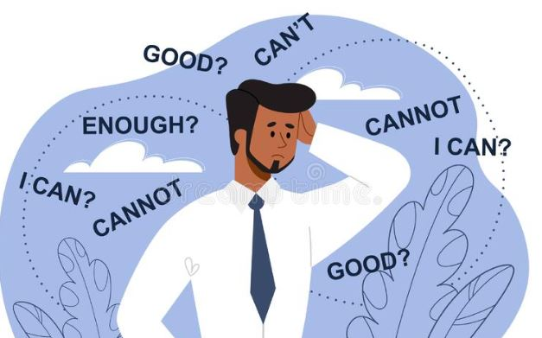
A TOUGH PROPOSITION… GOING AGAINST THE GRAIN
The Auto-Kinetic
Effect Experiment
Notes:
Many experiments indicate that our brains enjoy fitting in, avoiding standing out and are heavily influenced by social pressure.
1960 Auto-kinetic effect experiment by Shrief—WE HAVE a phycological bias towards ease. The person whose estimate of movement was greatly different from the other two CONFORMED to the view of the other two.
Many experiments indicate that our brains enjoy fitting in, avoiding standing out and are heavily influenced by social pressure.
1960 Auto-kinetic effect experiment by Shrief—WE HAVE a phycological bias towards ease. The person whose estimate of movement was greatly different from the other two CONFORMED to the view of the other two.
If we tend to do nothing or go along with others are doing because its easier this is a significant barrier to doing what’s right.
We need to press ourselves to do the hard thing….

Slide 18
IT’S TIME TO UP OUR GAME… …WE CAN DO THIS!
Not just Soft Skills…
SUPER SKILLS OF VIRTUE
Notes:
To instill HOPE AND CHANGE we so desperately want to see in our own lives and in the world around us…Super Skills

Slide 19
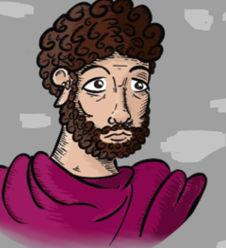
WHERE DO WE BEGIN? …FOUR KEY COMPONENTS TO VIRTUE
COURAGE
SELF CONTROL
JUSTICE
WISDOM
“These are the touchstones of goodness” – Marcus Aurelius
Notes:
To millions, they’re known as the cardinal virtues, four near-universal ideals adopted by most of Western philosophy, and just about every other philosophy. They’re called “cardinal,” (C. S. Lewis ), not because they come down from church authorities but because they originate from the Latin cardo, or hinge…
It’s pivotal stuff. It’s the stuff that the door to the good life hangs on.
Marcus Aurelius called them the “touchstones of goodness.” (A great Roman emperor and stoic philosopher)
“Carry these around like a compass.” (Ryan Holiday)
2000 years ago, Aurelius said: If you find anything better than these, hold on to it because it must be a extraordinary thing indeed!

Slide 20
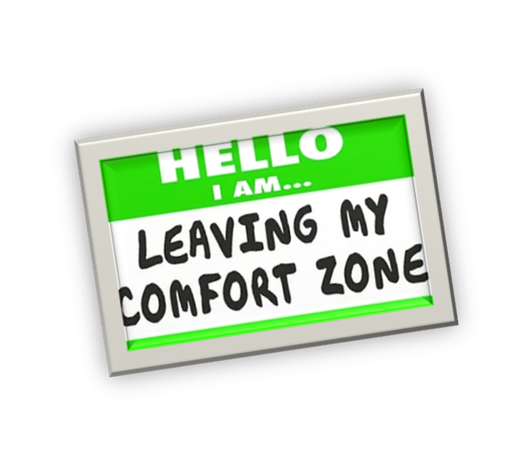
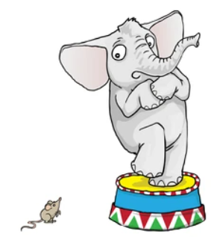
COURAGE-WHAT ARE WE AFRAID OF?
…A LOT!
COURAGE – bravery strength, honor and sacrifice
We feel ill-equipped
Too much to lose
Easier to let someone else do the fighting
It’s someone else's place
LET’S PRACTICE
BRAVERY!
Notes:
SUGGESTION:
Ask audience why they are afraid to stand up or speak up in an uncomfortable situation.
After they list theirs, Pop up the ones listed on PPT (ill-equipped, too much to lose, etc.) up on the screen.
What’s your reason?
Remember that some of the most influential and life changing things that have ever been done were done by ordinary people who said, “If not me, then who?”
Rosa Parks. Florence Nightingale, So many more examples…

Slide 21
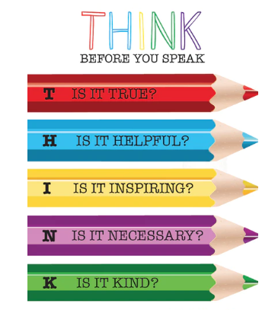
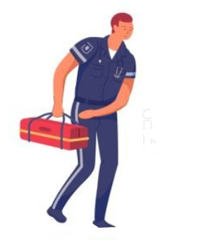
SELF CONTROL- WHAT’S THAT? …HOLDING OURSELVES TO A HIGHER STANDARD
SELF CONTROL – moderation, composure & balance
WALK-DON’T RUN
Notes:
CONSIDER HOLDING YOURSELF TO A HIGHER STANDARD AND GIVING OTHERS A PASS, INSTEAD OF THE OPPOSITE.
WE TEND TO JUDGE OTHERS BY THEIR ACTIONS BUT WE TYPICALLY JUDGE OURSELVES BY ONLY OUR INTENTIONS.
Self control- sometimes we allow things to build up because we don’t know how or are afraid to speak up, then we use anger to give us our courage. This is the improper way to handle things.
Also do not allow yourself to be charged by your environment and then passively let your emotions take control. EMTs and FIREFIGHTERS are told to never run, but to walk into any emergency situation. This is intentional, because allowing yourself to be charged by the excitement can influence your mindset, concentration and distract you from doing the proper thing.

Slide 22
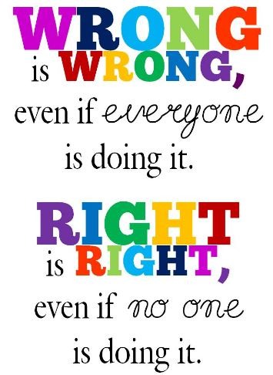
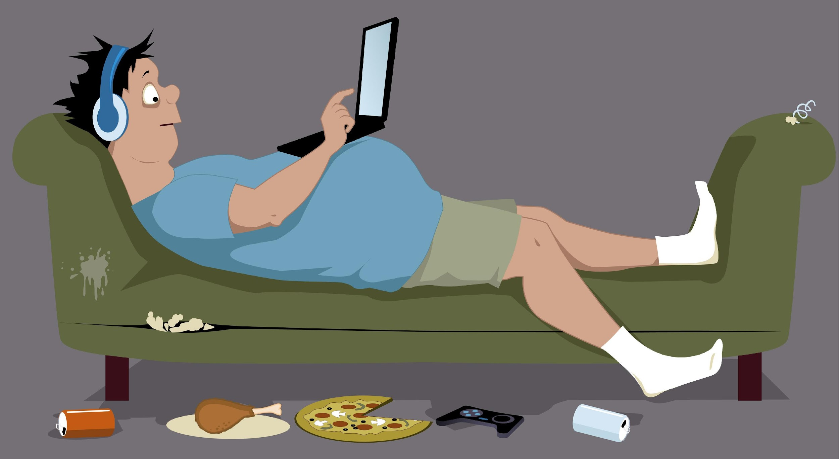
JUSTICE-WHERE DO WE BEGIN? …BY KNOWING WHAT’S RIGHT
JUSTICE – Integrity, fairness, goodness
The right thing is often the hard thing
The WRONG is often the comfortable thing
PEOPLE OF INTEGRITY:
Honest
Trustworthy
Give appropriate credit
Respectfully disagree
Notes:
We are living in an age where getting swept up in the crowd is not only admired, but almost demanded. Take time to be informed and stand firm for what is RIGHT, not what is popular.

Slide 23
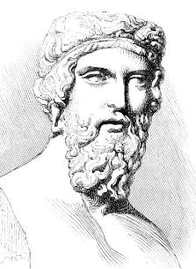
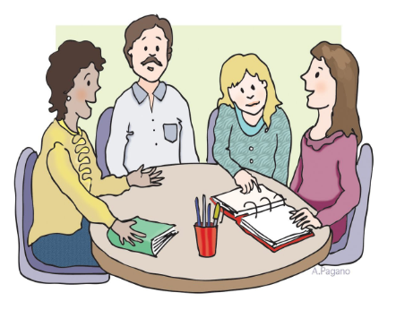
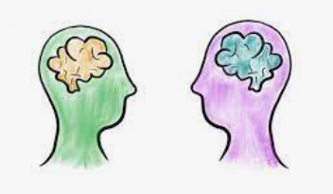
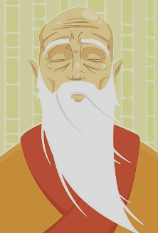
WISDOM-DO WE HAVE IT? …SEEK IT OUT CONTINUOUSLY; NEVER STOP LEARNING
WISDOM – knowledge, education, truth & discernment
Notes:
We need wisdom to know what’s right!
Learn about opposing views to have a balanced perspective.
makes you more tolerant of various groups of people
REDUCES your stress.
Makes you more effective in representing your views if you understand why people have concerns about your view.
Know why you believe what you believe before you are exceptionally outspoken, or before taking drastic action for your cause.
Your views should be based on more than a “gut feeling.”

Slide 24
4 GOOD VIRTUES…
BUT HOW DO I KNOW WHEN TO…
How can we be brave if we don’t know for what cause?
How can we be fair if we don’t know the facts?
How can I look out for others and not lose myself?
BE
KIND

Slide 25
THE VIRTUE THAT GUIDES THE OTHERS…
LET COMPASSION BE YOUR COMPASS
COURAGE – to stand up/speak up for others
SELF CONTROL – to be respectful and disagree civilly
JUSTICE – the Golden Rule
WISDOM – share what you know to be helpful and use your discernment to promote peace
COMPASSIONATE PEOPLE
Find joy in enriching the lives of those around them
Are emotionally intuitive because they can easily see
perspective outside their own
Apologize easily when they should
Are Genuine – Don’t just wear the T-Shirt
Are slow to react and get the facts
Notes:
COMPASSION DOESN’T MEAN WE AGREE WITH EVERYONE OR ACCEPT THE VALUES OF EVERYONE.
Agreeing with all views is not compassion, its actually harmful to overall well-being—BUT we can always be respectful.
THE GOLDEN RULE.

Slide 26
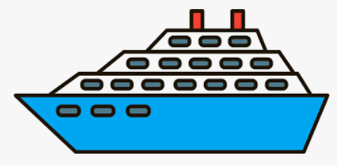
LET’S MODEL THE SUPER SKILLS
Notes:
Story of all the crew on the cruise ship never changing from pleasant voice tones and expressions in adversity and urgent situations, AND its effect on the overall experience of the passengers, and their memories of the experience.
How much more should we do this in healthcare?
Per Bill Carr…20% of our brain activity is “Mirror Neural Activity,” meaning: 20% of our brain’s reaction is based on what we are seeing or what is around us) (www.https://ShiftForBrains.com) To see how this works, do activity below.
Activity: AST Instructors Conference Feb 2023: Have people pair in twos. Decide who is Person 1 and Person 2. Have them stare very intently and seriously at each other for about 10 seconds without looking away or making an expression.
Then tell Person 1 to continue to do this, but to then instantly, without warning make a big funny grin.
When this happens Person 2 will also grin (and usually laugh too). They do not continue to look serious, but instantly and unintentionally grin or laugh just because the person staring at them did it.) A GREAT EXAMPLE OF HOW OUR INTENSITY OR JOY AFFECTS OTHERS!

Slide 27
THANK YOU!
WHAT ARE YOU BUILDING?
Notes:
END OF THIS PRESENTATION.
Anyone is welcome to use and share this PPT for the purpose of teaching and instruction.
Author: Glenda McCloskey, CST
GMcCloskey@GwinnettTech.edu
GlendaM@EarthSmartMedical.com

Slide 28
SUGGESTED READING FOR MORE ON THIS TOPIC:
THE CHOICE - Edith Eva Eger
COURAGE IS CALLING -Ryan Holiday
EGO IS THE ENEMY -Ryan Holiday
DISCIPLINE IS DESTINY -Ryan Holiday
THE OBSTACLE IS THE WAY -Ryan Holiday
MAN’S SEARCH FOR MEANING -Dr. Viktor Frankl
Notes:
Presented at the AST National Instructors Conference February 2023. Anyone is welcome to use and share this PPT for the purpose of teaching and instruction.
Author: Glenda McCloskey, CST
GMcCloskey@GwinnettTech.edu
GlendaM@EarthSmartMedical.com

